Slide 1
Doc Champa
Solidarité et Santé LAOS

Slide 3
How you’ve helped us in 2023
“ Association Doc Champa exists to make an impact in Laos. We have been working all the year to improve access to equitable eye healthcare in Laos ”

Slide 4
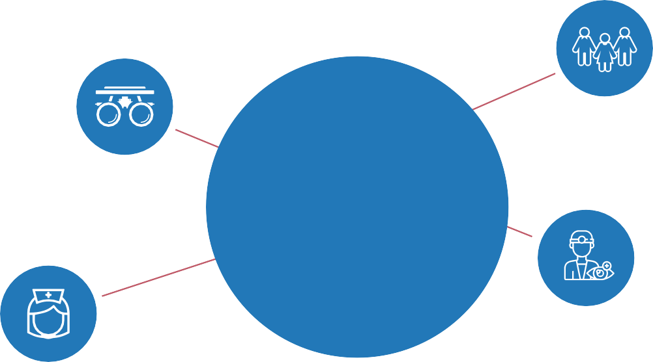
SEKONG & SALAVAN Provinces, Lao PDR.
600,000 People
Optometrists 0
FACTS
5 General Doctors
Nurses 37
2 Ophthalmologists

Slide 5
OUR IMPACT
Vision test, diagnosis 1478
In the 2 provincial
hospitals of Sekong & Salavan (Lao PDR) and 10
surrounded villages & schools
Provided glasses 1115
Cataract surgeries 97
Surgery
Other surgeries 12
Educational supplies
More than 800 books and supplies distributed in the schools

Slide 6
D O C
Lao 27
C H A M P A
D O C C H A
D O C C H A M P A
TEAM
35 MEMBERS
D O C C H A M P A
D O C C H A M P A
D O C C H A M P A
French 8

Slide 7
41 Individuals
3 continents
DONORS
6 countries
6 Companies & Institution
(WHG / OECD, Horus Pharma, BVI Medical,
Laboratoire Théa, Medico-Lions Club, Abioz technologies)

Slide 8
Manifestement, une incroyable réussite ...
et beaucoup de bonheur apporté aux personnes
que vous avez soignées ! Bravo à l'équipe !
”

Slide 9
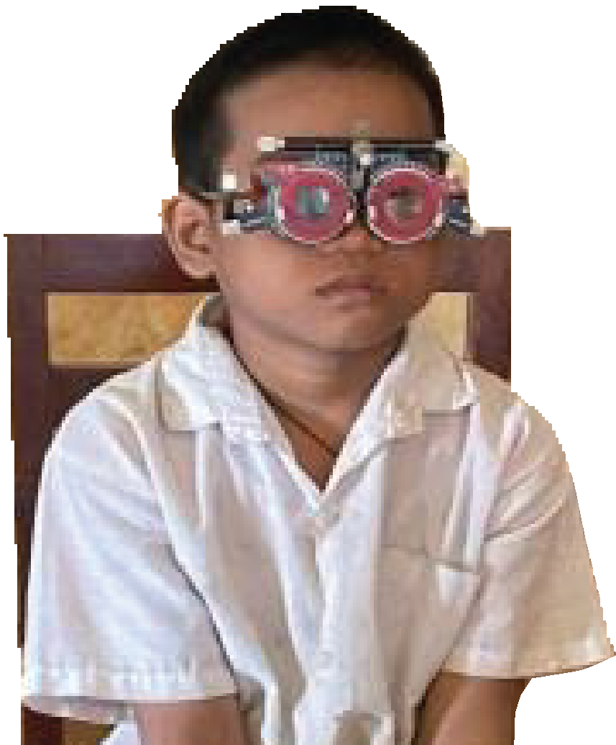
it’s incredible to see the impact your effortsare driving. ”

Slide 10
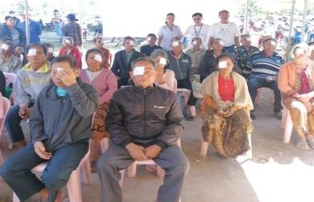
« What could be more gratifying than restoring sight to those who have lost it?"
« I'm particularly impressed by the number of villagers
who have benefited from the "MOBILE CARE EYE CARE"

Slide 11
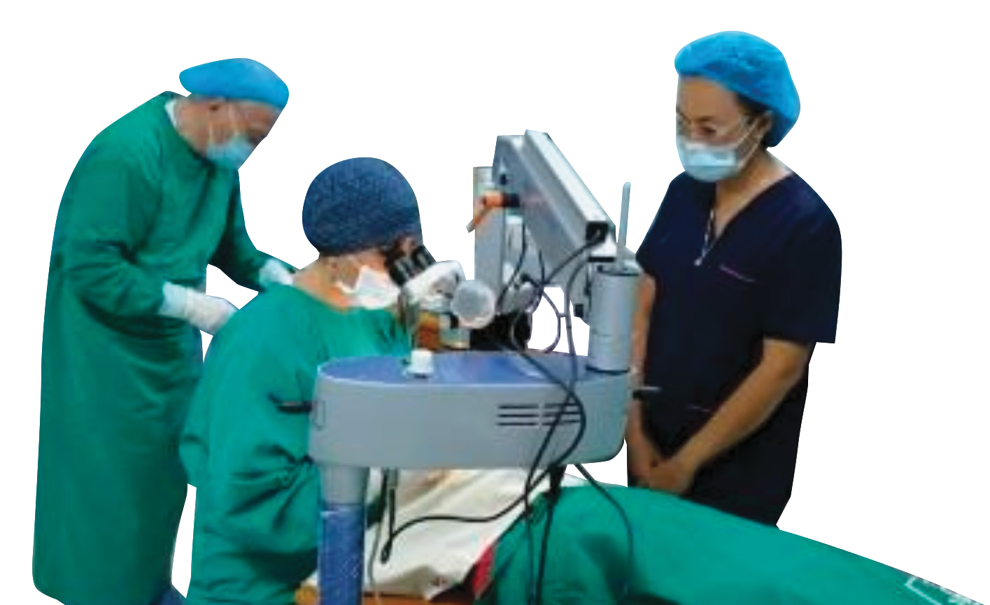
who needed you, to recover their eyesight! ”
Well done for changing the lives of all these patients,

Slide 12
Associationdocchampa@gmail.com

